Slide 1
Unit 3
Structured Query Language(SQL)

Slide 2
History of SQL:
SQL was one of the first commercial languages to use Edgar F. Codd’s relational model originally based upon relational algebra and tuple relational calculus.
The SQL language was originally developed at the IBM research laboratory in San José, in connection with a project developing a prototype for a relational database management system called System R in the early 70s.
The first database management systems based on SQL became available commercially by the end of the 70s.
At first it was named SEQUEL (Simple English Query Language) then after it is rename to Structured Query Language (SQL)

Slide 3
Structured Query Language (SQL)
Structured Query Language (SQL) is a programming language that is typically used in relational database or data stream management systems.
SQL is declarative language which has remained a consistently popular choice for database users over the years primarily due to its ease of use and the highly effective manner in which it queries, manipulates, aggregates data and performs a wide range of other functions to turn massive collections of structured data into usable information.

Slide 4
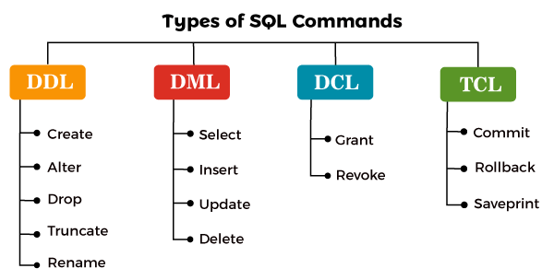
Categories of SQL Commands

Slide 5
Data Definition Language (DDL)
A data definition language (DDL) is a computer language used to create and modify the structure of database objects in a database. These database objects include database, schemas, tables, etc.
This term is also known as data description language in some contexts, as it describes the fields and records in a database table.
Commonly used DDL in SQL querying are CREATE, ALTER, DROP, and TRUNCATE.

Slide 6
CREATE Command:
This command builds a new table and has a predefined syntax. The CREATE statement syntax is:
CREATE DATABASE [database name];
For example:
CREATE DATABASE employee_management_system;
CREATE TABLE [table name] ([column definitions]) [table parameters];
For example:
CREATE TABLE employee (
e_id INTEGER PRIMARY KEY,
e_name VARCHAR (50),
e_address VARCHAR (75));
The mandatory semi-colon at the end of the statement is used to process every command before it. In this example, the VARCHAR is used to specify the data type. Other data types can be DATE, NUMBER, or INTEGER.

Slide 7
ALTER Command
An alter command modifies an existing database table. This command can add up additional column, drop existing columns and even change the data type of columns involved in a database table.
An alter command syntax is:
ALTER object type object name parameters;
For example:
ALTER TABLE table_name ADD column_name datatype;
ALTER TABLE employee ADD phone_number INT;
ALTER TABLE employee DROP COLUMN phone_number;
ALTER TABLE employee MODIFY COLUMN E_address CHAR(20);

Slide 8
TRUNCATE Command:
Similar to DROP, the TRUNCATE statement is used to quickly remove all records from a table. However, unlike DROP that completely destroys a table, TRUNCATE preserves its full structure to be reused later.
Truncate statement syntax is:
TRUNCATE TABLE table_name;
For example:
Suppose we have insert two records.
INSERT INTO employee VALUES(1,'ram','newroad');
INSERT INTO employee VALUES(2,'shyam','ason');
To view the table:
SELECT * FROM employee;
To drop all records:
TRUNCATE TABLE employee;
In this example, we’re marking all the extents of the Employee table for deallocation, so they’re considered empty for reuse.

Slide 9
Other statements
Other commonly used commands include RENAME. The first one is used with the ALTER TABLE statement to change the name of an object (table, column, etc.).
To change table name:
ALTER TABLE table_name RENAME TO new_table_name;
ALTER TABLE employee RENAME TO employee_details;
To change column name:
ALTER TABLE employee_details CHANGE e_name
e_fname VARCHAR(50);

Slide 10
DROP Command:
A drop command is used to delete objects such as a table, index or view. A DROP statement cannot be rolled back, so once an object is destroyed, there’s no way to recover it.
Drop statement syntax is:
DROP object type object name;
For example:
DROP TABLE employee_details;
DROP DATABASE employee_management_system;
In this example, we’re deleting the Employee table and database.

Slide 11
Data Manipulation Language (DML):
Data Manipulation Language (DML) commands in SQL deals with manipulation of data records stored within the database tables. It does not deal with changes to database objects and its structure. The commonly known DML commands are INSERT, UPDATE and DELETE. Liberally speaking, we can consider even SELECT statement as a part of DML commands. Albeit, it strictly forms part of the Data Query Language (DQL) command.

Slide 12
1. SELECT
SELECT command or statement in SQL is used to fetch data records from the database table and present it in the form of a result set. It is usually considered as a DQL command but it can also be considered as DML.
The basic syntax for writing a SELECT query in SQL is as follows :
SELECT column_name1, column_name2, … FROM table_name WHERE condition_ expression;
Eg.:
SELECT * FROM college;
Or
SELECT s_name FROM college;
Or
SELECT * FROM college WHERE s_id=1;

Slide 13
2. INSERT
INSERT commands in SQL are used to insert data records or rows in a database table. In an INSERT statement, we specify both the column_names for which the entry has to be made along with the data value that has to be inserted.
The basic syntax for writing INSERT statements in SQL is as follows :
INSERT INTO table_name (column_name_1, column_name_2, column_name_3, ...) VALUES (value1, value2, value3, ...)
Eg:
INSERT INTO college VALUES(1,'ram','newroad');
Or
INSERT INTO college(s_id, s_name) VALUES (4,'rita');

Slide 14
3. UPDATE
UPDATE command or statement is used to modify the value of an existing column in a database table.
The syntax for writing an UPDATE statement is as follows :
UPDATE table_name SET column_name_1 = value1, column_name_2 = value2, ... WHERE condition;
Eg :
UPDATE college SET s_name='hari' WHERE s_id=1;
UPDATE college SET s_name='ram', s_address='bagbazar' WHERE s_id=1;

Slide 15
4. DELETE
DELETE statement in SQL is used to remove one or more rows from the database table. It does not delete the data records permanently. With DELETE statements we can use the WHERE clause for filtering specific rows.
The syntax for writing an DELETE statement is as follows :
DELETE FROM table_name WHERE condition;
Eg :
DELETE FROM college WHERE s_id=2;

Slide 16
Operator used in SQL
Arithmetic operator:
Used for performing mathematical operation. Arithmetic operator are +, - , *, /,%.
Comparison operator: Are used to select, update and delete the record in relation based on condition specified in where clause. Comparison operator are
= : equals sign used for checking equality
!= : not equals sign ( <>). Used for checking non equality between any two expression >, < , <=, >=, !
Logical Operator/Conjuctive operator: Used to select, update and delete record based on one or more condition. Logical Operator are And, Or, Not.

Slide 17
Range Operator:
This operator can be used to select, update and delete the record based on the condition specified by certain range. Range operator are Between and Not Between
List operator: The list operator are used to select, update and delete the records based on condition specified by list of the values. List operator are ( In, Not In)

Slide 18
String Operator:
SQL includes a string-matching operator for comparison on character string. The operator Like matches the given string with the specified pattern. Pattern includes wild card and regular character. some of the wild card characters are:
% (percent) : represent any string of zero or N character
_ (underscore): represent single character
[ ] : represent any single character within a specified range
[^] : represent any single character not within the specified range

Slide 19
The Where Clause
Clauses are in-built functions available to us in SQL. With the help of clauses, we can deal with data easily stored in the table.
Clauses help us filter and analyze data quickly. When we have large amounts of data stored in the database, we use Clauses to query and get data required by the user.
The WHERE clause is used to filter records.
It is used to extract only those records that fulfill a specified condition.
WHERE Syntax:
SELECT column1, column2, ...
FROM table_name
WHERE condition;
Comparison results can be combined using the logical connectives and, or, and not.

Slide 20
The SQL AND, OR and NOT Operators
The WHERE clause can be combined with AND, OR, and NOT operators.
The AND and OR operators are used to filter records based on more than one condition:
The AND operator displays a record if all the conditions separated by AND are TRUE.
The OR operator displays a record if any of the conditions separated by OR is TRUE.
The NOT operator displays a record if the condition(s) is NOT TRUE.

Slide 21
AND Syntax
SELECT column1, column2, ... FROM table_name WHERE condition1 AND condition2 AND condition3 ...;
OR Syntax
SELECT column1, column2, ... FROM table_name WHERE condition1 OR condition2 OR condition3 ...;
NOT Syntax
SELECT column1, column2, ... FROM table_name WHERE NOT condition;

Slide 22
The SQL LIKE Operator
The LIKE operator is used in a WHERE clause to search for a specified pattern in a column.
There are two wildcards often used in conjunction with the LIKE operator:
The percent sign (%) represents zero, one, or multiple characters
The underscore sign (_) represents one, single character
The percent sign and the underscore can also be used in combinations!
LIKE Syntax
SELECT column1, column2, ... FROM table_name WHERE columnN LIKE pattern;

Slide 23
The SQL ORDER BY Keyword
The ORDER BY keyword is used to sort the result-set in ascending or descending order.
The ORDER BY keyword sorts the records in ascending order by default. To sort the records in descending order, use the DESC keyword.
ORDER BY Syntax
SELECT column1, column2, ... FROM table_name ORDER BY column1, column2, ... ASC|DESC;

Slide 24
The SQL SELECT DISTINCT Statement
The SELECT DISTINCT statement is used to return only distinct (different) values.
Inside a table, a column often contains many duplicate values; and sometimes you only want to list the different (distinct) values.
SELECT DISTINCT Syntax:
SELECT DISTINCT column1, column2, ... FROM table_name;

Slide 25
MySQL Data Types
CHAR(size):A FIXED length string (can contain letters, numbers, and special characters). The size parameter specifies the column length in characters - can be from 0 to 255. Default is 1.
VARCHAR(size):A VARIABLE length string (can contain letters, numbers, and special characters). The size parameter specifies the maximum column length in characters - can be from 0 to 65535.
INT(size):A medium integer. Signed range is from -2147483648 to 2147483647. Unsigned range is from 0 to 4294967295. The size parameter specifies the maximum display width (which is 255).
DATE: A date. Format: YYYY-MM-DD. The supported range is from '1000-01-01' to '9999-12-31‘.
DATETIME: A date and time combination. Format: YYYY-MM-DD hh:mm:ss. The supported range is from '1000-01-01 00:00:00' to '9999-12-31 23:59:59'. Adding DEFAULT and ON UPDATE in the column definition to get automatic initialization and updating to the current date and time
For more data types:
https://www.w3schools.com/sql/sql_datatypes.asp

Slide 26
SQL Constraints
NOT NULL - Ensures that a column cannot have a NULL value
UNIQUE - Ensures that all values in a column are different
PRIMARY KEY - A combination of a NOT NULL and UNIQUE. Uniquely identifies each row in a table
FOREIGN KEY - Prevents actions that would destroy links between tables
CHECK - Ensures that the values in a column satisfies a specific condition
DEFAULT - Sets a default value for a column if no value is specified

Slide 27
SQL NOT NULL Constraint
By default, a column can hold NULL values.
The NOT NULL constraint enforces a column to NOT accept NULL values.
This enforces a field to always contain a value, which means that you cannot insert a new record, or update a record without adding a value to this field.
Example
CREATE TABLE Persons (
ID int NOT NULL,
LastName varchar(255) NOT NULL,
FirstName varchar(255) NOT NULL,
Age int
);

Slide 28
SQL UNIQUE Constraint
The UNIQUE constraint ensures that all values in a column are different.
Both the UNIQUE and PRIMARY KEY constraints provide a guarantee for uniqueness for a column or set of columns.
A PRIMARY KEY constraint automatically has a UNIQUE constraint.
However, you can have many UNIQUE constraints per table, but only one PRIMARY KEY constraint per table.
Example :
CREATE TABLE Persons ( ID int NOT NULL, LastName varchar(255) NOT NULL, FirstName varchar(255), Age int, UNIQUE (ID) );

Slide 29
SQL PRIMARY KEY Constraint
The PRIMARY KEY constraint uniquely identifies each record in a table.
Primary keys must contain UNIQUE values, and cannot contain NULL values.
A table can have only ONE primary key; and in the table, this primary key can consist of single or multiple columns (fields).
CREATE TABLE Persons ( ID int PRIMARY KEY, LastName varchar(255) NOT NULL, FirstName varchar(255), Age int );

Slide 30
SQL FOREIGN KEY Constraint
The FOREIGN KEY constraint is used to prevent actions that would destroy links between tables.
A FOREIGN KEY is a field (or collection of fields) in one table, that refers to the PRIMARY KEY in another table.
The table with the foreign key is called the child table, and the table with the primary key is called the referenced or parent table.
CREATE TABLE Orders ( OrderID int PRIMARY KEY NOT NULL, OrderNumber int NOT NULL, PersonID int, FOREIGN KEY (PersonID) REFERENCES Persons(PersonID) );

Slide 31
SQL CHECK Constraint
The CHECK constraint is used to limit the value range that can be placed in a column.
If you define a CHECK constraint on a column it will allow only certain values for this column.
If you define a CHECK constraint on a table it can limit the values in certain columns based on values in other columns in the row.
CREATE TABLE Persons ( ID int NOT NULL, LastName varchar(255) NOT NULL, FirstName varchar(255), Age int, CHECK (Age>=18) );

Slide 32
SQL DEFAULT Constraint
The DEFAULT constraint is used to set a default value for a column.
The default value will be added to all new records, if no other value is specified.
CREATE TABLE Persons ( ID int NOT NULL, LastName varchar(255) NOT NULL, FirstName varchar(255), Age int, City varchar(255) DEFAULT 'Sandnes' );

Slide 33
Aggregate Functions
These functions operate on the multiset of values of a column of a relation, and return a value
avg: average value
min: minimum value
max: maximum value
sum: sum of values
count: number of values

Slide 34
The SQL MIN() and MAX() Functions
The MIN() function returns the smallest value of the selected column.
The MAX() function returns the largest value of the selected column.
MIN() Syntax
SELECT MIN(column_name) FROM table_name WHERE condition;
MAX() Syntax
SELECT MAX(column_name) FROM table_name WHERE condition;

Slide 35
The SQL COUNT(), AVG() and SUM() Functions
The COUNT() function returns the number of rows that matches a specified criterion.
COUNT() Syntax
SELECT COUNT(column_name)
FROM table_name
WHERE condition;
The AVG() function returns the average value of a numeric column.
AVG() Syntax
SELECT AVG(column_name)
FROM table_name
WHERE condition;
The SUM() function returns the total sum of a numeric column.
SUM() Syntax
SELECT SUM(column_name)
FROM table_name
WHERE condition;

Slide 36
Nested Query/ Sub Query:
A Subquery or Inner query or a Nested query is a query within another SQL query and embedded within the WHERE clause.
A subquery is used to return data that will be used in the main query as a condition to further restrict the data to be retrieved.
Subqueries can be used with the SELECT, INSERT, UPDATE, and DELETE statements along with the operators like =, <, >, >=, <=, IN, BETWEEN, etc.

Slide 37
Syntax:
Subqueries are most frequently used with the SELECT statement. The basic syntax is as follows −
SELECT column_name
FROM table1 WHERE column_name OPERATOR
(SELECT column_name
FROM table1 [WHERE]);

Slide 38
Nested query using aggregate function example:
Display all information of employees who is getting minimum salary among all the employees.
SELECT * FROM employee WHERE salary=
(SELECT MAX(salary) FROM employee);
Display all information of employees who is getting second highest salary among all the employees.
SELECT * FROM employee WHERE salary =(
SELECT MAX(salary) FROM employee WHERE salary !=(
SELECT MAX(salary) FROM employee));

Slide 39
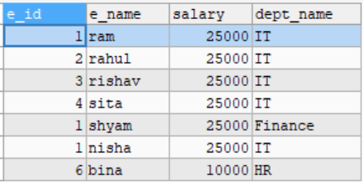
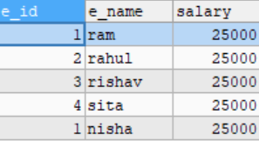
Example for Nested Query Insertion:
Suppose we have Employee (e_id, e_name, salary and dept_name )table which have tons of data.
So we have to make IT (e_id, e_name and salary) table which are in department of IT.
So we can use following query:
INSERT INTO it(e_id, e_name, salary)
SELECT e_id, e_name,salary FROM employee WHERE dept_name='IT';
Employee table
IT table

Slide 40
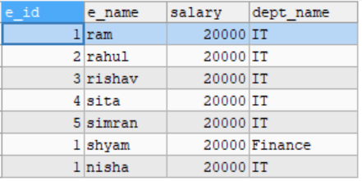
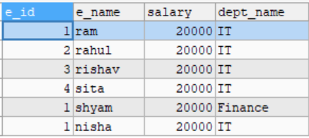
Example for Nested Query Deletion:
DELETE FROM employee WHERE e_id=( SELECT MAX(e_id) FROM employee);
Before
After

Slide 41
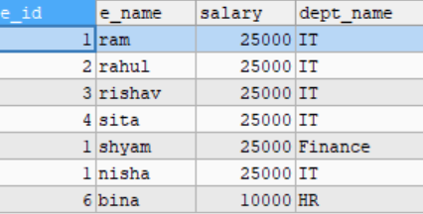
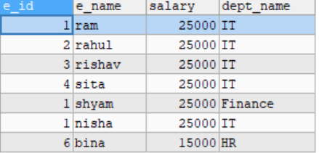
Example of Update using Nested Query:
UPDATE employee SET salary = salary + 5000
WHERE salary =
(SELECT MIN(salary) FROM employee);
Before update
After update

Slide 42
Set Membership
In SQL, set membership refers to the concept of checking whether a specific value exists within a defined set of values. This is primarily achieved using the IN and NOT IN operators.
SELECT name, city FROM customers WHERE city IN ('New York', 'London', 'Paris’);
SELECT product_name FROM products WHERE product_id IN (SELECT product_id FROM order_details WHERE quantity > 10);

Slide 43
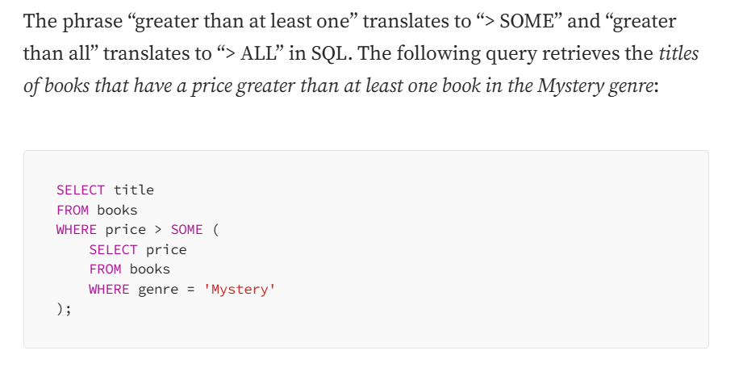
Set Comparison
Set comparison in SQL involves comparing the elements of one set (typically represented by the result of a SELECT statement) with the elements of another set. This is achieved using various operators and clauses.

Slide 44
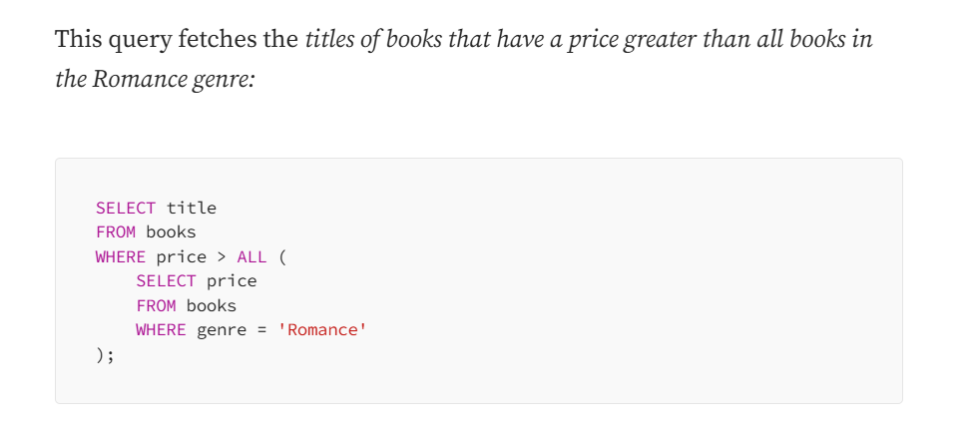
Set Comparison

Slide 45
Set Comparison
Similarly < SOME, <= SOME, >= SOME, = SOME and <> SOME (Not equal to any value in a set) can be used for various comparisons. Also, < ALL, <= ALL, >= ALL, = ALL and <> ALL can be used for comparisons.
= SOME is identical to IN, but <> SOME is not the same as NOT IN
“<> SOME” compares a value with each value returned by the subquery, including NULL values. If any comparison with a non-NULL value from the subquery evaluates to true, the overall condition is true. However, if no comparison with non-NULL values evaluates to true but there are NULL values in the subquery result, the overall condition still evaluates to true.
“NOT IN” compares a value with each value in a set specified explicitly in parentheses. If any comparison evaluates to true, the overall condition is true. However, if any value in the set is NULL, the entire condition evaluates to unknown rather than true or false.
= ALL is not the same as IN
<> ALL is similar to NOT IN

Slide 46
Test for empty relations
The SQL EXISTS condition is used to test whether a correlated subquery returns any results. If the subquery returns at least one row, the EXISTS condition evaluates to TRUE; otherwise, it evaluates to FALSE. The EXISTS operator can be used in various SQL statements like SELECT, UPDATE, INSERT, and DELETE to filter data based on whether certain conditions are met.

Slide 47
Test for empty relations
When to Use SQL EXISTS
Checking Data Existence: You can use EXISTS to check if related data exists in another table before performing an action (e.g., selecting, updating, deleting).
Performance: EXISTS is often more efficient than using IN when dealing with large datasets, as it stops searching once a match is found.
Correlated Subqueries: EXISTS is ideal for correlated subqueries, where the subquery refers to the outer query’s values.

Slide 48
Test for empty relations
Syntax:
SELECT column_name(s)
FROM table_name
WHERE EXISTS (
SELECT column_name(s)
FROM subquery_table
WHERE condition
);

Slide 49
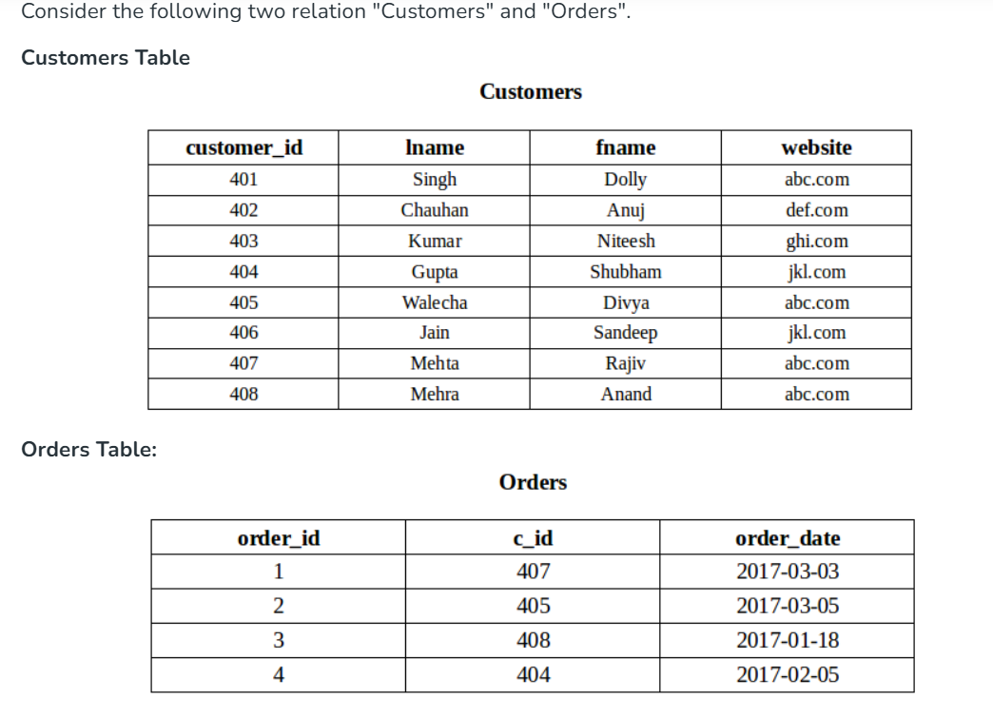
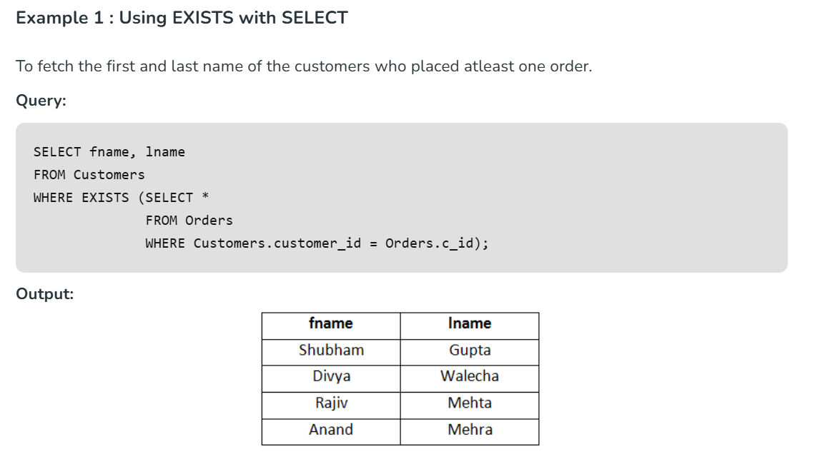
Test for empty relations

Slide 50
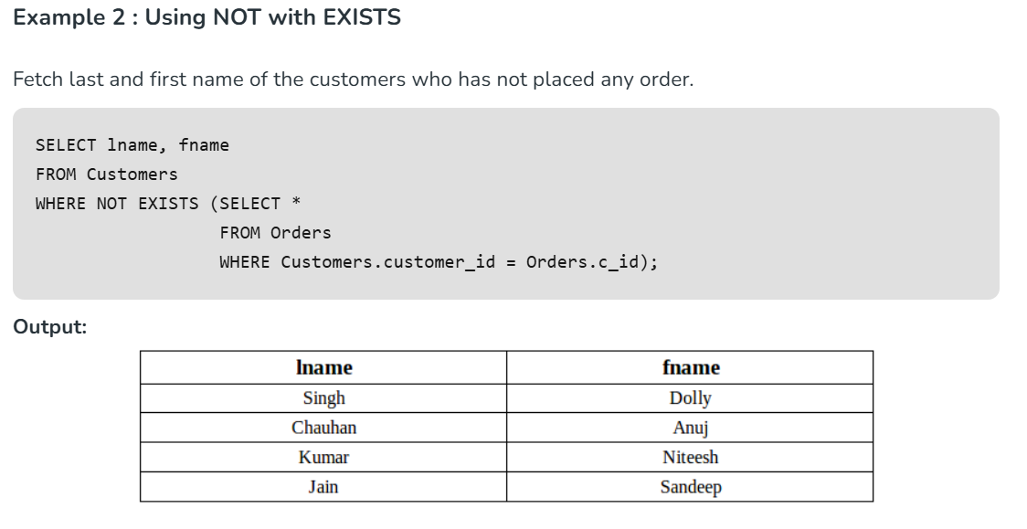
Test for empty relations

Slide 51
Test for absence of duplicate tuples
To test for the absence of duplicate tuples in SQL, the UNIQUE construct can be employed within a WHERE clause, specifically in conjunction with a subquery. This construct returns TRUE if the subquery's result set contains no duplicate tuples, and FALSE otherwise. It also returns TRUE for an empty set.

Slide 52
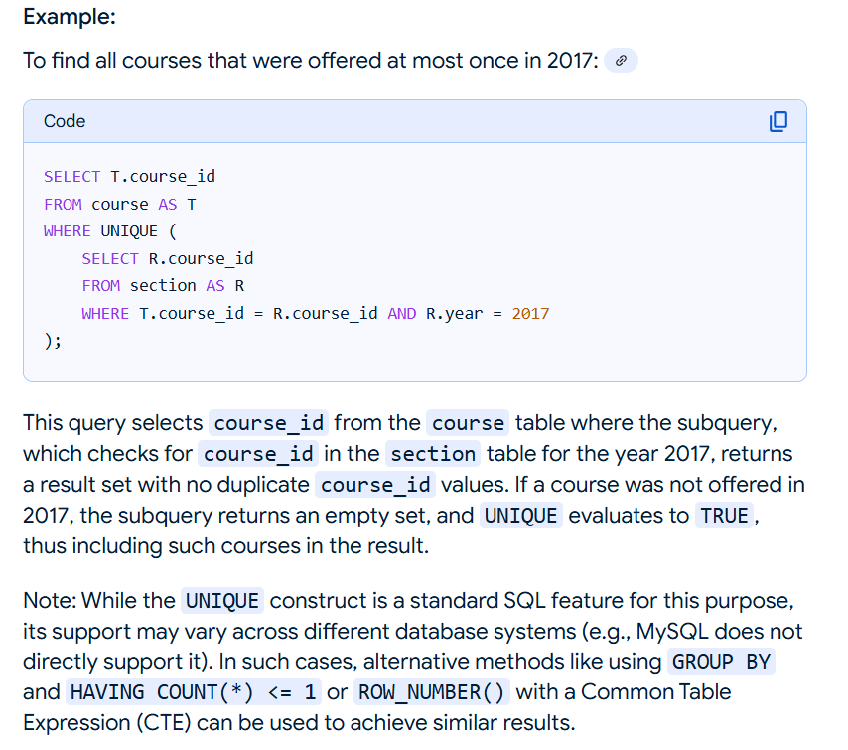
Test for absence of duplicate tuples

Slide 53
MySQL GROUP BY Clause
The MYSQL GROUP BY Clause is used to collect data from multiple records and group the result by one or more column. It is generally used in a SELECT statement.
You can also use some aggregate functions like COUNT, SUM, MIN, MAX, AVG etc. on the grouped column.
Syntax:
SELECT expression1, expression2, ... expression_n,
aggregate_function (expression)
FROM tables
[WHERE conditions]
GROUP BY expression1, expression2, ... expression_n;

Slide 54
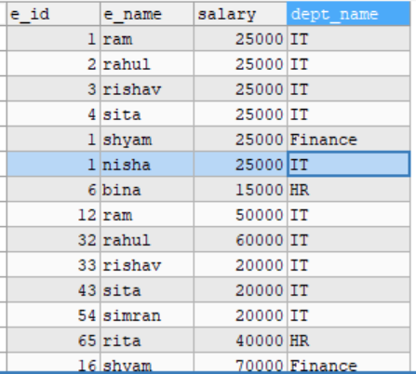
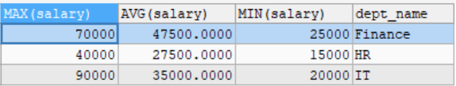
Example:
Group all department with department name, maximum, average and minimum salary.
SELECT MAX(salary), AVG(salary), MIN(salary), dept_name FROM employee GROUP BY dept_name;
Output:
Before Group By clause
After Group By clause

Slide 55
The SQL HAVING Clause
The HAVING clause was added to SQL because the WHERE keyword cannot be used with aggregate functions.
The following SQL statement lists the number of customers in each country. Only include countries with more than 5 customers:
SELECT COUNT(CustomerID), Country FROM Customers GROUP BY Country HAVING COUNT(CustomerID) > 5;
For more info.
https://www.datacamp.com/community/tutorials/group-by-having-clause-sql?utm_source=adwords_ppc&utm_medium=cpc&utm_campaignid=1455363063&utm_adgroupid=65083631748&utm_device=c&utm_keyword=&utm_matchtype=&utm_network=g&utm_adpostion=&utm_creative=332602034364&utm_targetid=aud-517318241987%3Adsa-429603003980&utm_loc_interest_ms=&utm_loc_physical_ms=1011034&gclid=Cj0KCQiA09eQBhCxARIsAAYRiynPHA4JGcfblSHReMHTONg3-TTkrF4eld4Nr2-I2nGLW4mA6o5KoPEaAve1EALw_wcB&fbclid=IwAR2e_iOdIM1RIogjOsxU4-qQi0ufaFYBTKhR6sCA3EcTsXe2hMdemb5-a_s

Slide 56
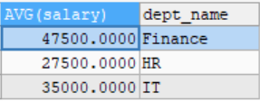

Example:
Group all department with average salary and using having clause to find average salary more than 30,000.
SELECT AVG(salary), dept_name FROM employee GROUP BY dept_name HAVING AVG(salary)>=30000;
Before using having clause
After using having clause

Slide 57
The SQL IN Operator
The IN operator allows you to specify multiple values in a WHERE clause.
The IN operator is a shorthand for multiple OR conditions.
Syntax :
SELECT column_name(s) FROM table_name WHERE column_name IN (value1, value2, ...);

Slide 58
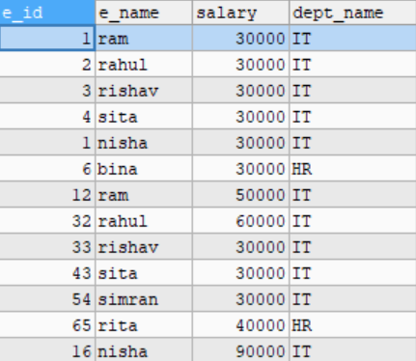
Example
SELECT * FROM employee WHERE dept_name IN ('IT','HR');
Or
SELECT * FROM employee WHERE dept_name='IT' OR dept_name='HR';

Slide 59
The SQL BETWEEN Operator
The BETWEEN operator selects values within a given range. The values can be numbers, text, or dates.
The BETWEEN operator is inclusive: begin and end values are included.
Example:
SELECT * FROM Products WHERE Price BETWEEN 10 AND 20;

Slide 60
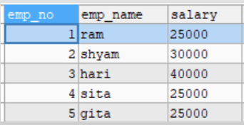
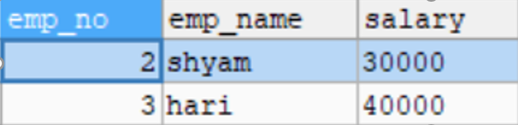
Example:
SELECT * FROM employee WHERE salary BETWEEN 30000 AND 40000;
Before
After

Slide 61
SQL Aliases
SQL aliases are used to give a table, or a column in a table, a temporary name.
Aliases are often used to make column names more readable.
An alias only exists for the duration of that query.
An alias is created with the AS keyword.
Alias Column Syntax:
SELECT column_name AS alias_name FROM table_name;

Slide 62


Example:
SELECT COUNT(*) AS Total_employee FROM employee;
Before
After

Slide 63
The SQL CASE Statement
The CASE statement goes through conditions and returns a value when the first condition is met (like an if-then-else statement). So, once a condition is true, it will stop reading and return the result. If no conditions are true, it returns the value in the ELSE clause.
If there is no ELSE part and no conditions are true, it returns NULL. CASE Syntax:
CASE WHEN condition1 THEN result1 WHEN condition2 THEN result2 WHEN conditionN THEN resultN ELSE result END;

Slide 64
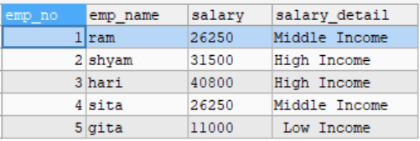
Example 1:
SELECT *,
CASE
WHEN salary>=1000 AND salary<=20000 THEN ' Low Income'
WHEN salary>20000 AND salary<=30000 THEN 'Middle Income'
WHEN salary>30000 THEN 'High Income‘
ELSE ‘Invalid’
END
AS
salary_detail
FROM employee;

Slide 65
Example 2:
UPDATE employee SET salary=
CASE
WHEN salary>=1000 AND salary<=20000 THEN salary+salary*0.10
WHEN salary>20000 AND salary<=30000 THEN salary+salary*0.05
WHEN salary>30000 THEN salary+salary*0.02
END
SELECT * FROM employee;

Slide 66
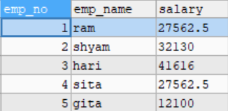
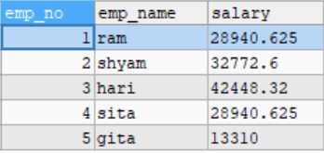
Example 2 cont.:
Before
After

Slide 67
SQL | Join
A SQL Join statement is used to combine data or rows from two or more tables based on a common field between them. Different types of Joins are:
NATURAL JOIN
INNER JOIN
LEFT JOIN
RIGHT JOIN
FULL JOIN
CROSS JOIN

Slide 68
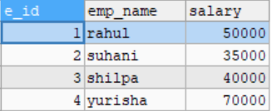
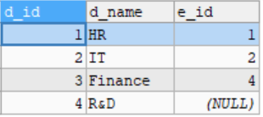
Consider the two tables below:
Department Table
Student table

Slide 69
INNER JOIN:
The INNER JOIN keyword selects all rows from both the tables as long as the condition satisfies. This keyword will create the result-set by combining all rows from both the tables where the condition satisfies i.e value of the common field will be same.
Syntax:
SELECT table1.column1,table1.column2,table2.column1,....
FROM table1
INNER JOIN table2
ON table1.matching_column = table2.matching_column;
Note:
table1: First table.
table2: Second table
matching_column: Column common to both the tables

Slide 70
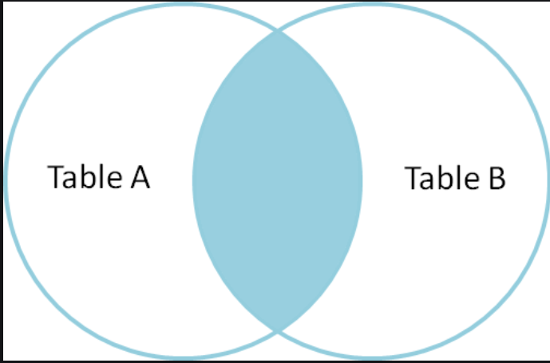
Example:

Slide 71
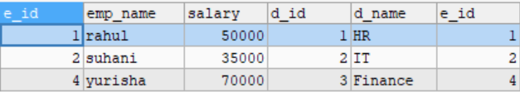
Example:
This query will show the names and age of students enrolled in different courses.
SELECT * FROM employee INNER JOIN department ON employee.e_id=department.e_id;

Slide 72
LEFT JOIN
This join returns all the rows of the table on the left side of the join and matching rows for the table on the right side of join. The rows for which there is no matching row on right side, the result-set will contain null. LEFT JOIN is also known as LEFT OUTER JOIN.
Syntax:
SELECT table1.column1,table1.column2,table2.column1,....
FROM table1
LEFT JOIN table2
ON table1.matching_column = table2.matching_column;

Slide 73
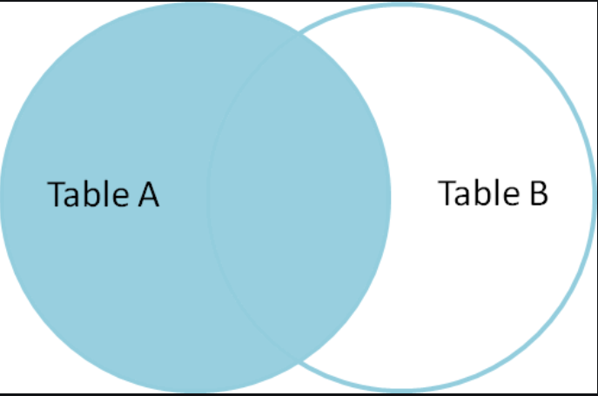
Example:

Slide 74
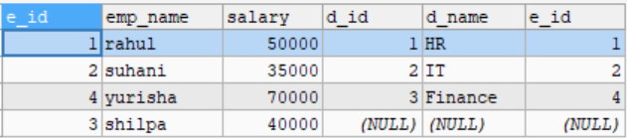
Example:
SELECT * FROM employee LEFT JOIN department ON employee.e_id=department.e_id;

Slide 75
RIGHT JOIN
RIGHT JOIN is similar to LEFT JOIN. This join returns all the rows of the table on the right side of the join and matching rows for the table on the left side of join. The rows for which there is no matching row on left side, the result-set will contain null. RIGHT JOIN is also known as RIGHT OUTER JOIN.
Syntax:
SELECT table1.column1,table1.column2,table2.column1,....
FROM table1
RIGHT JOIN table2
ON table1.matching_column = table2.matching_column;

Slide 76
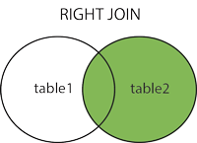
Example:

Slide 77
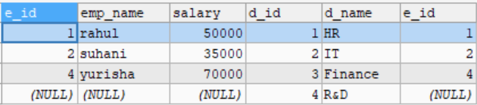
Example:
SELECT * FROM employee LEFT JOIN department ON employee.e_id=department.e_id;

Slide 78
FULL JOIN
FULL JOIN creates the result-set by combining result of both LEFT JOIN and RIGHT JOIN. The result-set will contain all the rows from both the tables. The rows for which there is no matching, the result-set will contain NULL values.
Syntax:
SELECT table1.column1,table1.column2,table2.column1,....
FROM table1
FULL JOIN table2
ON table1.matching_column = table2.matching_column;

Slide 79
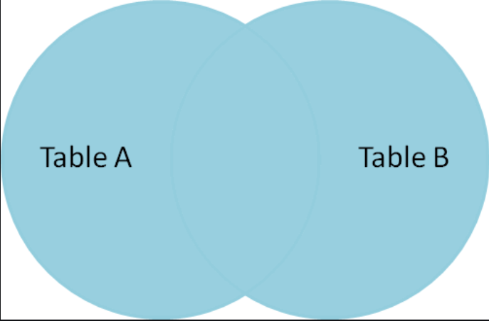
Example:

Slide 80
NATURAL JOIN
Natural join is an SQL join operation that creates join on the base of the common columns in the tables. To perform natural join there must be one common attribute(Column) between two tables.
We will perform the natural join query by using the following syntax.
SELECT *
FROM TABLE1
NATURAL JOIN TABLE2;

Slide 81
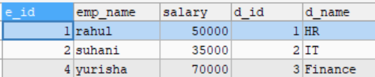
Example:
SELECT * FROM employee NATURAL JOIN department;

Slide 82
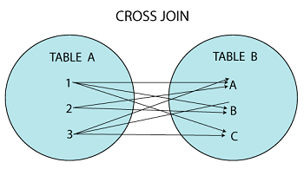
CROSS JOIN
A cross join is a type of join that returns the Cartesian product of rows from the tables in the join. In other words, it combines each row from the first table with each row from the second table.

Slide 83
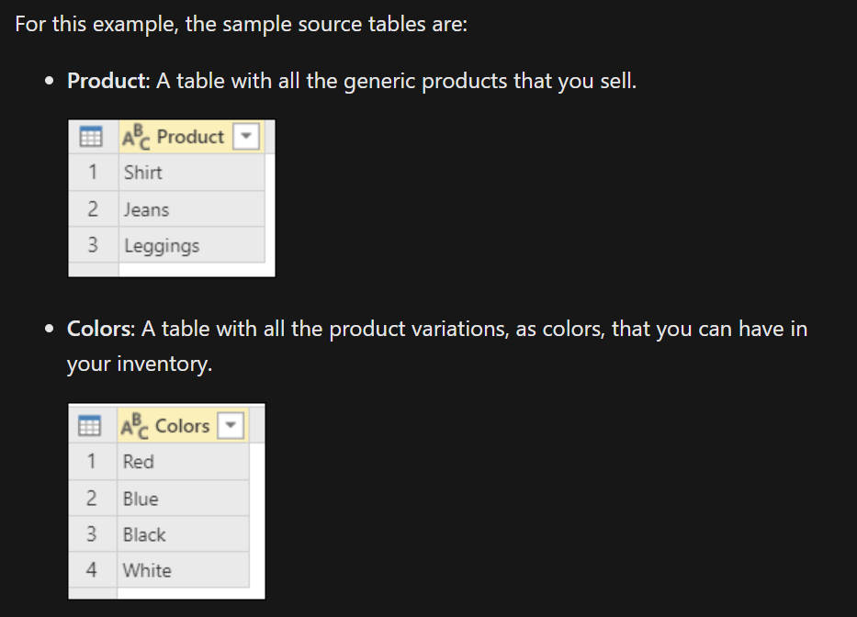
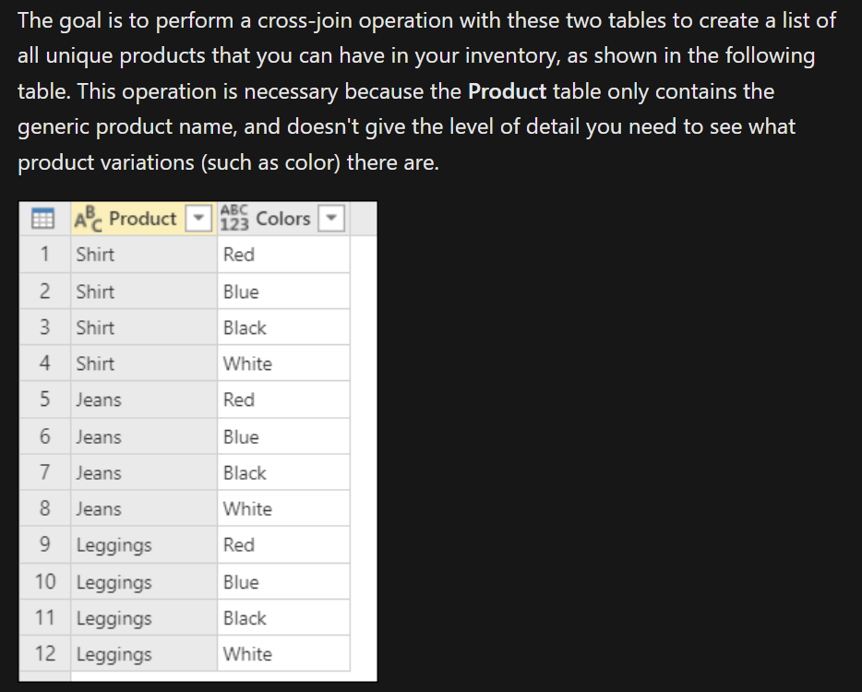
Example:

Slide 84
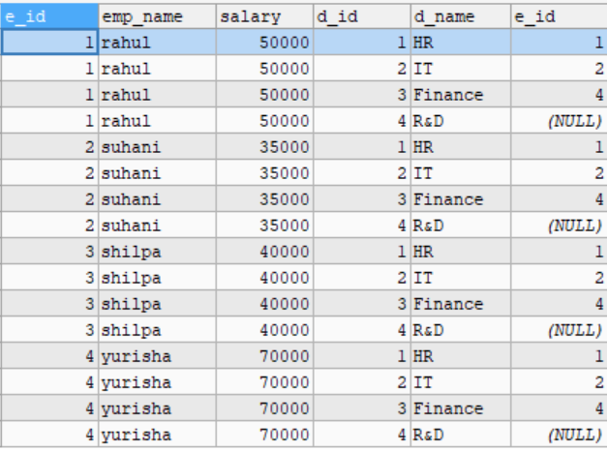
Example:
SELECT * FROM employee CROSS JOIN department;

Slide 85
The SQL UNION Operator
The UNION operator is used to combine the result-set of two or more SELECT statements.
Every SELECT statement within UNION must have the same number of columns
The columns must also have similar data types
The columns in every SELECT statement must also be in the same order
UNION Syntax:
SELECT column_name(s) FROM table1 UNION SELECT column_name(s) FROM table2;

Slide 86
UNION ALL Syntax
The UNION operator selects only distinct values by default. To allow duplicate values, use UNION ALL:
Syntax :
SELECT column_name(s) FROM table1 UNION ALL SELECT column_name(s) FROM table2;
Note: The column names in the result-set are usually equal to the column names in the first SELECT statement.

Slide 87
The SQL EXISTS Operator
The EXISTS operator is used to test for the existence of any record in a subquery.
The EXISTS operator returns TRUE if the subquery returns one or more records.
Syntax :
SELECT column_name(s) FROM table_name WHERE EXISTS (SELECT column_name FROM table_name WHERE condition);

Slide 88
SQL - EXCEPT Operator
The SQL EXCEPT clause/operator is used to combine two SELECT statements and returns rows from the first SELECT statement that are not returned by the second SELECT statement. This means EXCEPT returns only rows, which are not available in the second SELECT statement.

Slide 89
SQL - INTERSECT Operator
The INTERSECT operator in SQL is used to combine two SELECT statements but the dataset returned by the INTERSECT statement will be the intersection of the data-sets of the two SELECT statements. In simple words, the INTERSECT statement will return only those rows which will be common to both of the SELECT statements.

Slide 90
SQL LIMIT
The SQL SELECT LIMIT statement is used to retrieve records from one or more tables in a database and limit the number of records returned based on a limit value.
The syntax for the SELECT LIMIT statement in SQL is:
SELECT expressions
FROM tables
[WHERE conditions]
[ORDER BY expression [ ASC | DESC ]]
LIMIT number_rows [ OFFSET offset_value ];

Slide 91
Example:
SELECT * FROM hospital INNER JOIN doctor ON hospital.doc_id=doctor.doc_id ORDER BY salary DESC LIMIT 2;
Output:

Slide 92
SQL CREATE VIEW Statement
In SQL, a view is a virtual table based on the result-set of an SQL statement.
A view contains rows and columns, just like a real table. The fields in a view are fields from one or more real tables in the database.
You can add SQL statements and functions to a view and present the data as if the data were coming from one single table.
A view is created with the CREATE VIEW statement.

Slide 93
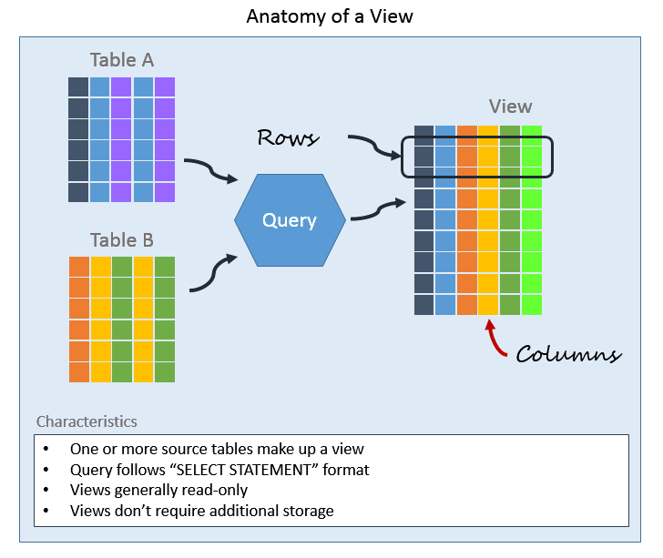
Example:

Slide 94
CREATE VIEW Syntax
CREATE VIEW view_name AS SELECT column1, column2, ... FROM table_name WHERE condition;

Slide 95
Example:
CREATE VIEW doctor_patient1
AS SELECT p_name,doc_name, des_name
FROM patient INNER JOIN doctor ON patient.doc_id= doctor.doc_id
INNER JOIN disease ON doctor.doc_id=disease.doc_id ;
SELECT * FROM doctor_patient1;

Slide 96
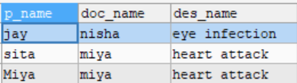
Example:
Output

Slide 97
DELETING VIEWS
We have learned about creating a View, but what if a created View is not needed any more? Obviously we will want to delete it. SQL allows us to delete an existing View. We can delete or drop a View using the DROP statement.
Syntax :
DROP VIEW view_name;
view_name: Name of the View which we want to delete.

Slide 98
Question
By taking reference from your lab sheet 4, Create VIEW and select patient’s, doctor’s, disease’s name and salary. Use INNER JOIN and select all information from view named ‘doctor_patient2’.

Slide 99
Embedded SQL
Embedded SQL is a method of inserting inline SQL statements or queries into the code of a programming language, which is known as a host language.
Because the host language cannot parse SQL, the inserted SQL is parsed by an embedded SQL preprocessor.
Embedded SQL is a robust and convenient method of combining the computing power of a programming language with SQL's specialized data management and manipulation capabilities.
Embedded SQL are SQL statements in an application that do not change
at runtime and, therefore, can be hard-coded into the application

Slide 100
Dynamic SQL
Dynamic Structured Query Language (SQL) is a SQL version that facilitates the generation of dynamic (or variable) program queries.
Dynamic SQL allows a programmer to write code that automatically adjusts to varying databases, environments, servers or variables.
Dynamic SQL statements are not embedded in the source program but stored as strings of characters that are manipulated during a program's runtime.
These SQL statements are either entered by a programmer or automatically generated by the program.
Dynamic SQL facilitates automatic generation and manipulation of program modules for efficient automated repeating task preparation and performance.

Slide 101
TCL (Transaction Control Language) :
Transaction Control Language commands are used to manage transactions in the database. These are used to manage the changes made by DML-statements. It also allows statements to be grouped together into logical transactions.
Examples of TCL commands –
COMMIT: Commit command is used to permanently save any transaction into the database.
ROLLBACK: This command restores the database to last committed state.

Slide 102
DCL (Data Control Language) :
A Data Control Language is a syntax similar to a computer programming language used to control access to data stored in a database (Authorization). In particular, it is a component of Structured Query Language (SQL).
Examples of DCL commands :
GRANT: allow specified users to perform specified tasks.
REVOKE: cancel previously granted or denied permissions.

